Slide 1
FINAL PROJECT
CIT COURSE:

Slide 2
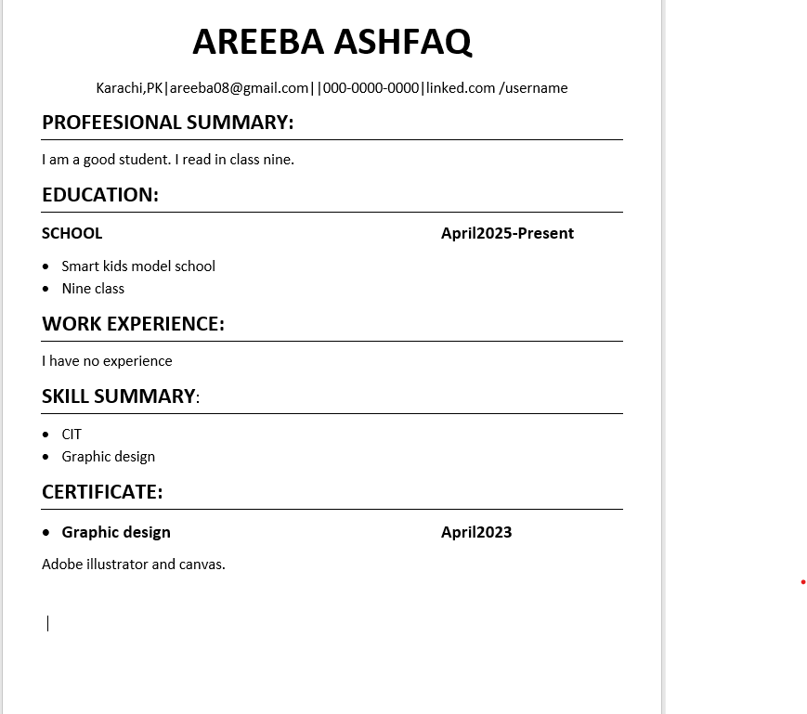
RESUME:
“I prepared a detailed presentation on Curriculum Vitae (CV). In this presentation, I explained the main sections that should be included in a good CV:
Summary: A brief introduction about yourself, your career goals, and what you offer to employers.
Skills: Highlighting your relevant skills that match the job requirements.
Education: Listing your academic qualifications, including degrees, institutions, and dates.
Certificates: Including any certifications or training that support your skills and add value.
Work Experience: Describing your previous jobs, roles, responsibilities, and achievements.
I also discussed tips on how to format the CV clearly, tailor it for specific jobs, and make it professional to improve the chances of getting hired.

Slide 3
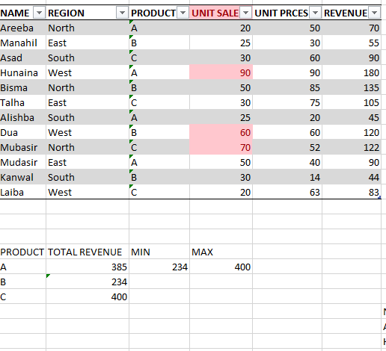
SPREED SHEET:
“I created a detailed spreadsheet to organize, manage, and analyze data effectively. The spreadsheet includes multiple columns and rows to input relevant information clearly. I used formulas and functions such as SUM, AVERAGE, and IF statements to automate calculations and data analysis. Additionally, I applied formatting techniques like conditional formatting and filters to make the data easier to read and interpret. This spreadsheet helps in tracking progress, managing resources, or summarizing complex data.

Slide 4
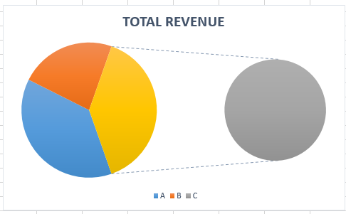
CHARTS:
“I made a bar chart in Excel to show monthly sales. Each bar represents one month, and the height of the bar shows the total sales in that month. This helps quickly understand which month had the highest or lowest sales.”

Slide 5
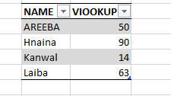
VLOOKUP:
“I created a VLOOKUP function in Excel to find related information from a data table. For example, I used it to search for a student’s name using their ID number. The function helped save time and reduce manual searching. I also formatted the data and used ‘FALSE’ for an exact match to make sure the results were accurate.”

Slide 6
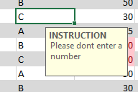
DATA VALIDATION:
Data validation in Microsoft Excel is a feature that helps control the type of data entered into a worksheet. It allows users to set rules that restrict entries to specific values, such as numbers within a certain range, dates, or text from a predefined list. This ensures data accuracy, reduces errors, and maintains consistency across the spreadsheet. By using data validation, you can prevent incorrect or unwanted entries, making your data more reliable and easier to manage.
.

